Slide 1

WIS 2.0 Pilot Phase
Hassan Haddouch
WIS 2.0 Manager

Slide 2
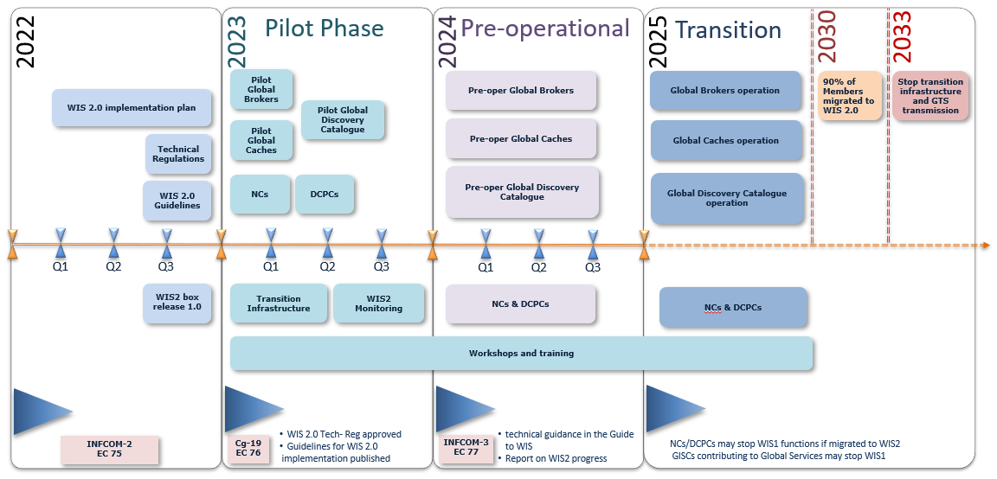
WIS 2.0 implementation Timeline

Slide 3
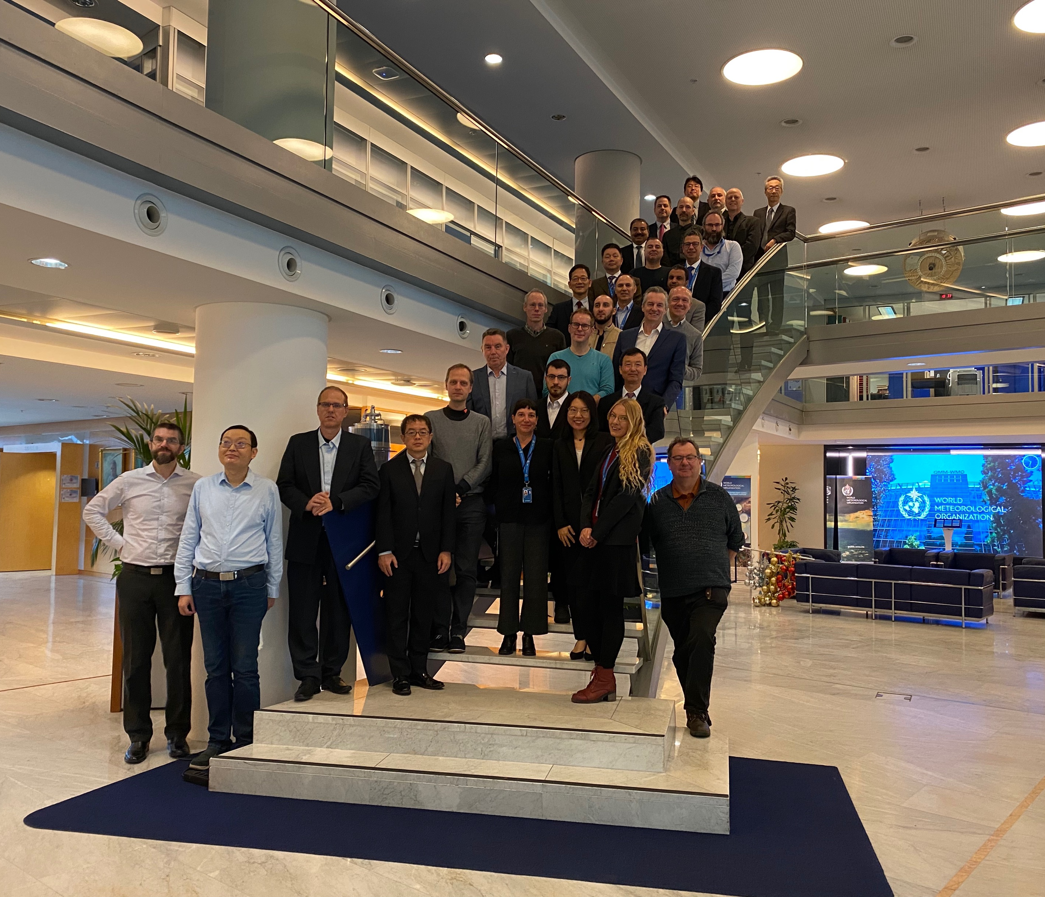
Introduction
First Coordination Meeting of WIS 2.0 Pilot Phase, Geneva, 5-7 December 2022
More than 67 (35 physical, 32 online) experts from 20 Countries met in Geneva for the first coordination meeting of the WIS 2.0 pilot phase.
Presentations are available in:
First Coordination Meeting of WIS 2.0 Pilot Phase | World Meteorological Organization (wmo.int)

Slide 4


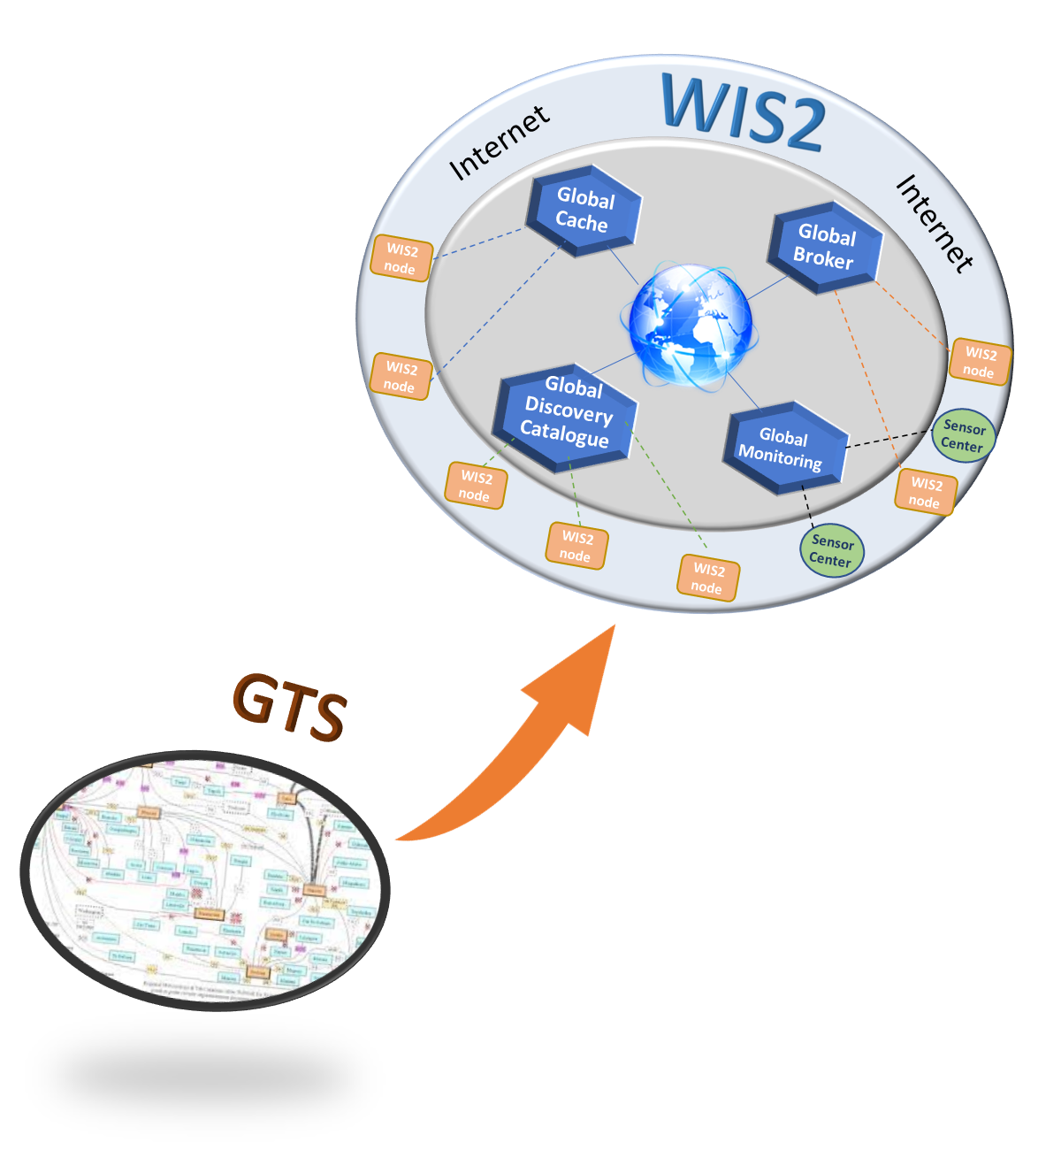



Goals of the pilot phase
Initiate the transition phase
Specify Monitoring
Complete Guide to WIS
Amend Manual on WIS
Improve technical aspects
Refine
WIS 2.0 architecture
Deploy WIS2 Node/WIS2 box
Deploy Global Services
Deploy Global Services

Slide 5
Organization
Chair
Rémy Giraud SC-IMT chair
Jeremy Tandy Vice-chair SC-IMT
Project Manager
Enrico Fucile
Hassan Haddouch
WMO
Project Team
Pilot phase Team
Project Board
ET-W2AT
TT/ET
Rémy Giraud
Jeremy Tandy
Weiqing Qu
Tom Kralidis
Peng Wang
Kari Sheets
Kai-Thorsten Wirt
Büßelberg Thorsten
Tsunoda Kenji
Nishikawa Shigeharu
Abderraouf Kadem
Pablo Loyber
Paolo Rosci
Tomas Karlsson
Hyunmin EOM
Rabia Merrouchi
Simon Elliott
Bauduoin Raoult
Kevin Alder
Juan Bianchi
Dwayne Scott
João Carlos
Øystein Godøy
Matías Méndez
Enrico Boldrini
Global Services
WIS2 Node
Programmes

Slide 6


Identify Success Criteria
Sharing data through GS by running WIS2 Node
Sharing data through GS covering all WMO programmes by running WIS2 Node
WIS 2.0
Validate Technical Regulations
Running Global Services
France Q3/2022
China
Global Broker
Indonesia
Algeria (WIS2 box)
Argentina
Italy
Morocco (WIS2 box)
Sweden
ECMWF
EUMETSAT
Hydrology:
Argentina
Brazil
Uruguay
Climate:
Belize
Cryosphere:
Norway
Ocean
USA
Germany Q3/2022
Australia
Global Cache
Japan
Korea
Volume II
WIS 2.0
USA - Synoptic
Global Discovery Catalogue
Canada
Korea
China
Global Monitoring
Morocco

Slide 7
Work Packages
WP7 – Registration and Credential Management
WP8 – Transition
WP1 – Global Broker
WP2 – Global Cache
WP3 – Global Discovery Catalogue
WP4 – Global Monitoring
WP5 – National Centre Nodes
WP6 – WMO programmes
WP9 – Interface with ICAO
WP10 – WIS 2.0 Documentation
WP11 – Monitoring & Reporting

Slide 8
Work Packages
Global Services
Lead: France
Participants: Indonesia, France, China, USA
Design and develop Global Brokers
Provide metrics on system performance and data availability
WP1 – Global Broker
Lead: Germany
Participants: Australia, Germany, Japan, Korea, USA
Design and develop Global Caches
Provide metrics on system performance and data availability
WP2 – Global Cache
WP3 – Global Discovery Catalogue
Lead – Canada
Participants: Canada, China, Korea
Design and develop Global Catalogues
Provide metrics on system performance and data availability
WP4 – Global Monitoring
Morocco
Develop metrics and KPIs to monitor the transition to WIS 2.0

Slide 9
Work Packages
WIS2 Node
Algeria, Argentina, Italy, Morocco, Sweden
Define datasets and topics,
Implement WIS2 node and share data through the Global Services
WP5 – National Centre Nodes
WP6.1 GDPFS ECMWF TT-NWPMD
WP6.2 – Satellite EUMETSAT
WP6.3 – Hydrology TT-W2FH Argentina, Brazil, Uruguay
WP6.4 - Cryosphere: Norway
WP6.5 - Climate: Belize
WP6.6 – Ocean
WP6.7 - GAW
Define datasets and topics Implement WIS2 node and share data through the Global Services
Define datasets and topics, Implement WIS2 node and share data through the Global Services
Develop the topic hierarchy and metadata Implement WIS2 node and share data through the Global Services
Develop the topic hierarchy and metadata Implement WIS2 node and share data through the Global Services
Define datasets and topics Implement WIS2 node and share data through the Global Services
Identify a pilot project
Identify a pilot project
WP6 – WMO Programmes

Slide 10
Work Packages
Management & Reporting
WMO
Develop procedure and test the mechanism to register new WIS2 nodes
WP7 – Registration and Credential Management
WP8.1 Gateway from GTS to WIS 2.0
WP8.2 Gateway from WIS 2.0 to GTS
GCs will provide gateway GTS to WIS2
WP8.2 Gateway from WIS 2.0 to GTS
WP8 – Transition
WP9 – Interface with ICAO
Task Team on WIS2/SWIM
Interoperability between WIS2 and SWIM
Editorial Team
Manual, Guide update
WP10 – WIS2 documentation
WMO
Define KPIs
Final report
WIS11 – Monitoring & Reporting

Slide 11
Planning
Cg-19
22 May - 2 June
All Global Services available
+
3 WIS2 Nodes
1 additional WMO programme
+
WIS2 to GTS Gateway
3 additional WIS2 Nodes
+
1 additional WMO programme
3 additional WIS2 Nodes
+
1 WMO programme
+
GTS to WIS2 Gateway
Second meeting
Pilot phase report
End of Q1-2023
End of Q3-2023
End of Q4-2023
Q4-2023
End 2023
End of Q2-2023

Slide 12

Thank you
Merci
Gracias
شكرا
谢谢

